Slide 1


LECTURE 4: ARM Cortex-M architecture overview
EMBEDDED SYSTEM COURSE
Notes:
Hỏi lại kiến thức bài cũ.
Giới thiệu nội dung bài mới: Kiến trúc về Cortex-M, trong đó tập trung về Cortex M0/M0+.
Mục đích của bài giảng, nhằm giúp học viên có khái niệm cơ bản về ARM CortexM, bao gồm: architecture, programer model, instruction set, core register (general/ status/ control registers).
Trước khi vào bài mới, giới thiệu qua về ARM Ltd.
ARM (Advanced RISC Machines) founded in November 1990
Company headquarters: Cambridge, UK
- Processor design centers in Cambridge, Austin, and Sophia Antipolis
- Sales, support, and engineering offices all over the world
Best known for its range of RISC processor cores designs
Other products – fabric IP, software tools, models, cell libraries - to help partners develop and ship ARM-based SoCs
ARM does NOT manufacture silicon
More information about ARM: ttp://www.arm.com/aboutarm/

Slide 2
Learning Goals
Introduce about the ARM Cortex M processor.
Explain some core components in Cortex-M including NVIC, SysTick timer and Floating Point Unit.
Explain about the basic concepts on Cortex-M instruction set.
Notes:
All the ARM Cortex M processors are 32-bit RISC (Reduced Instruction Set
Computing) processors. They have:
32-bit registers
32-bit internal data path
32-bit bus interface
The Cortex-M processors contain the core of the processor, NVIC, the SysTick timer, and optionally the floating point unit (for Cortex-M4).
All the ARM Cortex -M processors are based on Thumb technology, which allows a mixture of 16-bit and 32-bit instructions to be used within

Slide 3

Table of contents
General Information about the Cortex-M
Introduction to the architecture
Programmer Model
Instruction Set
Summary
Notes:
Giới thiệu về các mục của buổi học:
Phần 1: Giới thiệu thông tin tổng quan về ARM Cortex, các dòng chip của ARM, sự khác nhau giữa các dòng.
Phần 2: Giới thiệu về kiến trúc tổng quan của ARM Cortex
Phần 3: Programmer Model
Phần 4: Kiến trúc tập lệnh sử dụng trong Arm cortex
Phần 5: Tổng kết

Slide 4
Table of contents
General Information about the Cortex-M
Introduction to the architecture
Programmer Model
Instruction Set
Summary
Notes:
Giới thiệu về các mục của buổi học:
Phần 1: Giới thiệu thông tin tổng quan về ARM Cortex, các dòng chip của ARM, sự khác nhau giữa các dòng.
Phần 2: Giới thiệu về kiến trúc tổng quan của ARM Cortex
Phần 3: Programmer Model
Phần 4: Kiến trúc tập lệnh sử dụng trong Arm cortex
Phần 5: Tổng kết

Slide 5
General Information about the Cortex-M
Development of the ARM Architecture
v4
v5
v6
v7
Halfword and signed halfword / byte support
System mode
Thumb instruction set (v4T)
Improved interworking
CLZ
Saturated arithmetic
DSP MAC instructions
Extensions:
Jazelle (5TEJ)
SIMD Instructions
Multi-processing
v6 Memory architecture
Unaligned data support
Extensions:
Thumb-2 (6T2)
TrustZone® (6Z)
Multicore (6K)
Thumb only (6-M)
Thumb-2
Architecture Profiles
7-A - Applications
7-R - Real-time
7-M - Microcontroller
Cortex M0/M0+
Cortex M1
Cortex M3/M4
Notes:
Giới thiệu sự phát triển các kiến trúc trong ARM core, tập trung vào kiến trúc v6 và v7.
Version 4
– Add the signed, unsigned half-word and signed byte load and store instructions
– System mode is introduced
Version 4T
– 16-bit Thumb compressed form of the instruction set is introduced
Version 5T
– Introduced recently, a superset of version 4T adding the BLX, CLZ and BRK
instructions
Version 5TE
Add the signal processing instruction set extension
Version 6/7
– Media processing extensions (SIMD)
• 2x faster MPEG4 encode/decode
• 2x faster audio DSP
– Improved cache architecture
• Physically addressed caches
• Reduction in cache flush/refill
• Reduced overhead in context switches
– Improved exception and interrupt handling
• Important for improving performance in real-time tasks
– Unaligned and mixed-endian data support
• Simpler data sharing, application porting and saves memory
Note: V7: Support Thumb-2 Only

Slide 6

General Information about the Cortex-M
ARM CORTEX
The ARM Cortex family includes processors based on the three distinct profiles of the ARMv7 architecture. The A profile for sophisticated, high-end applications running open and complex operating systems The R profile for real-time systems The M profile optimized for cost-sensitive and microcontroller applications
Notes:
Cortex-M : The ARM Cortex-M is a group of 32-bit RISC ARM processor cores licensed by ARM Holdings. The cores are intended for microcontroller use, and consist of the Cortex-M0, Cortex-M0+, Cortex-M1, Cortex-M3, and Cortex-M4
The Cortex-M family is optimized for cost and power sensitive MCU and mixed-signal devices for end applications such as smart metering, human interface devices, automotive and industrial control systems, white goods, consumer products and medical instrumentation.
Cortex-R: The ARM Cortex-R is a group of 32-bit RISC ARM processor cores licensed by ARM Holdings. The cores are intended for robust real-time use, and consists of the Cortex-R4, Cortex-R5, Cortex-R7
The ARM® Cortex®-R real-time processors offer high-performance computing solutions for embedded systems where reliability, high availability, fault tolerance, maintainability and real-time responses are required. Features:High performance, real-time, Safe, Cost effective
(Note: Cortex A: series of applications processors provide an entire range of solutions for devices hosting a rich OS platform and user applications ranging from ultra-low-cost handset through smartphones, mobile computing platforms, digital TV and set-top boxes to enterprise networking, printers and server solutions.

Slide 7
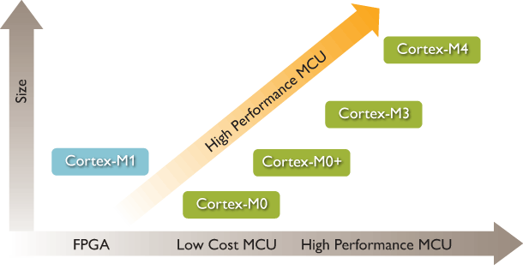
General Information about the Cortex-M
Embedded Processors

Slide 8
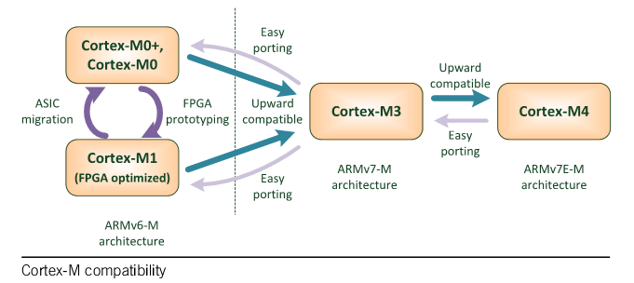
General Information about the Cortex-M
Cortex M processor
Notes:
Cortex-M family processors are all binary upwards compatible, enabling software reuse and a seamless progression from one Cortex-M processor to another.
Note: Cortex M0/M0+/M1: Von Neunman architecuture / Thumb-2 base on arm v6-m
Cortex M3/4 : Harvard / Thumb-2 base on ARMv7M
Topic thảo luận: Chương trình viết cho Cortex M0, có build đc trên Cortex M3 ko ? Và ngược lại ? Tại sao?

Slide 9
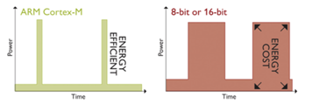
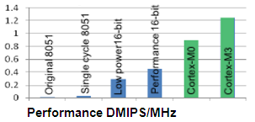
General Information about the Cortex-M
Cortex-M Advantages:
Energy efficiency
Smaller code
Ease of use
High performance
Notes:
Energy efficiency
Lower energy costs, longer battery life
Run at lower MHz or with shorter activity periods
Architected support for sleep modes
Work smarter, sleep longer than 8/16-bit
Smaller code
Lower silicon costs
High density instruction set
Achieve more per byte than 8/16-bit devices
Smaller RAM, ROM or Flash requirement
Ease of use
Faster software development and reuse
Global standard across multiple vendors
Code compatibility
Unified tools and OS support
High performance
More competitive products
Powerful Cortex-M processor
Delivers more performance per MHz
Enables richer features at lower power

Slide 10
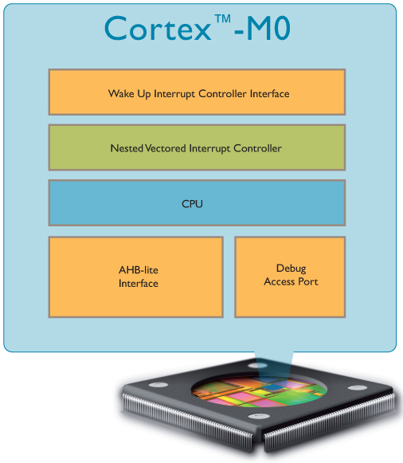
General Information about the Cortex-M
Cortex M0
32-bit RISC processor
3-stage pipeline von Neumann architecture
ARMv6-M architecture
16-bit Thumb instruction set with Thumb-2 technology.
Load-Store Architecture
56 Instructions
Low power support
Notes:
Note: Cortex M0+: 2 stage pipeline

Slide 11
Table of contents
General Information about the Cortex-M
Introduction to the architecture
Programmer Model
Instruction Set
Summary
Notes:
Giới thiệu về các mục của buổi học:
Phần 1: Giới thiệu thông tin tổng quan về ARM Cortex, các dòng chip của ARM, sự khác nhau giữa các dòng.
Phần 2: Giới thiệu về kiến trúc tổng quan của ARM Cortex
Phần 3: Programmer Model
Phần 4: Kiến trúc tập lệnh sử dụng trong Arm cortex
Phần 5: Tổng kết

Slide 12
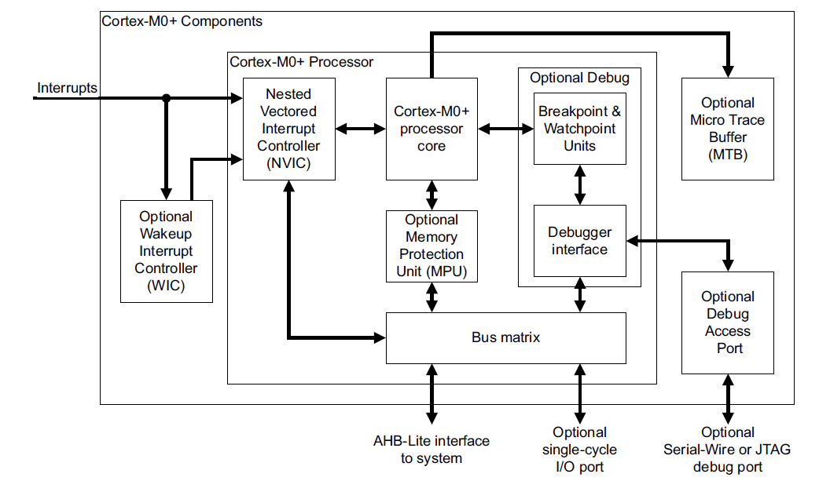
Introduction to the architecture
Simplified Block Diagram

Slide 13
Introduction to the architecture
ARMv6-M Thumb instruction set
NVIC: 32 external interrupt inputs
Debug: 4 HD breakpoints, 2 watchpoints.
Bus interfaces: 32-bit AMBA-3 AHB-Lite system interface
Cortex-M0 Functional Blocks

Slide 14
Introduction to the architecture
Memory model
32-bit address space
Virtual memory is not supported in ARMv6-M.
Instruction fetches are always half-word-aligned
Data accesses are always naturally aligned

Slide 15
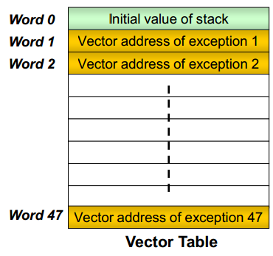
Introduction to the architecture
Exception model
An exception may be an interrupt or a hardware error.
Each exception has exception number, priority number and vector address
Vector table base address is fixed at 0x00.

Slide 16
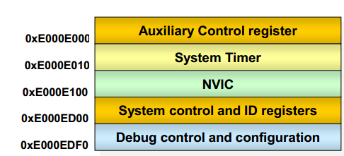
Introduction to the architecture
System control space
Consists of the following groups:
CPUID space.
System control, configuration
and status.
SysTick system timer
Nested Vectored Interrupt Controller (NVIC)
Notes:
System Control Space:
System control register
■ Cortex-M0 status and operating mode
Including CPUID, CortexM0 interrupt priority and Cortex M0 management
SysTick: 24-bit clear-on-write, decrementing, wrap-on-zero counter.
- be used as a Real Time Operating System (RTOS) tick timer or as a simple counter.
- The reference clock can be the core clock or an external clock source.
NVIC (Nested Vectored Interrupt Controller)
Upon stack based exception model
Restore registers to resume to normal execution automatically
Remove redundant PUSH/POP operations needed by traditional C-based ISRs.
Supports up to 32 (IRQ[31:0]) discrete interrupts which can be either level-sensitive or pulse-sensitive.

Slide 17
Table of contents
General Information about the Cortex-M
Introduction to the architecture
Programmer Model
Instruction Set
Summary

Slide 18
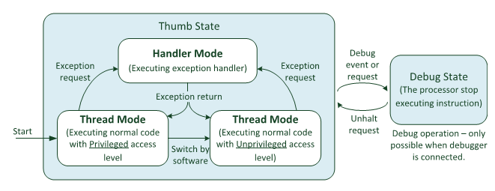
Programmer’s Model
Operation Modes & States
Notes:
ARM Cortex M support two operation mode:
Thread mode
Used to execute application software. The processor enters Thread mode when itcomes out of reset.
Handler mode
Used to handle exceptions. The processor returns to Thread mode when it hasfinished all exception processing.
Note:
Other ARM architectures support the concept of privileged or unprivileged software execution. This processor does not support different privilege levels. Software execution is always privileged, meaning software can access all the features of the processor.
The debug state is used for debugging operations only. This state is entered by a
halt request fromthe debugger, or by debug events generated fromdebug components
in the processor.

Slide 19
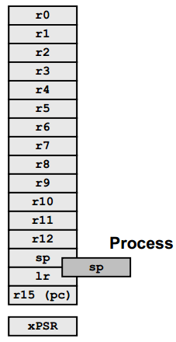
Programmer’s Model
Core Registers
All registers are 32 bits wide
13 general purpose registers
Registers r0 – r7 (Low registers)
Registers r8 – r12 (High registers)
3 registers with special meaning/usage
Stack Pointer (SP) – r13
Link Register (LR) – r14
Program Counter (PC) – r15
Special-purpose registers
xPSR shows a composite of the content of
APSR, IPSR, EPSR
Notes:
Register Usage
R0 – R3: Arguments into function Result(s) from function otherwise corruptible (Additional parameters passed on stack)
R4-R11: Register variables. Must be preserved
R12: Scratch register (corruptible)
R13 Stack Pointer (SP)
R14 Link Register (LR)
R15 Program Counter (PC)
Note: The compiler has a set of rules known as a Procedure Call Standard that determine how to pass parameters to a function (see APCS) CPSR flags may be corrupted by function call. Assembler code which links with compiled code must follow the AAPCS at external interfaces. The AAPCS is part of the ABI for the ARM Architecture

Slide 20
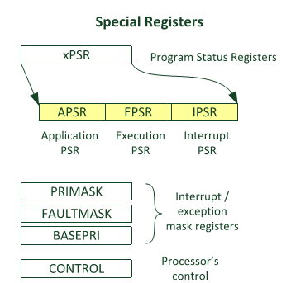

Programmer’s Model
Special Registers
Notes:
Register Usage
R0 – R3: Arguments into function Result(s) from function otherwise corruptible (Additional parameters passed on stack)
R4-R11: Register variables. Must be preserved
R12: Scratch register (corruptible)
R13 Stack Pointer (SP)
R14 Link Register (LR)
R15 Program Counter (PC)
Note: The compiler has a set of rules known as a Procedure Call Standard that determine how to pass parameters to a function (see APCS) CPSR flags may be corrupted by function call. Assembler code which links with compiled code must follow the AAPCS at external interfaces. The AAPCS is part of the ABI for the ARM Architecture

Slide 21
Programmer’s Model
Stack
Full descending: stack pointer indicates the last stacked item on the stack memory.
Two stacks, two independent stack pointers.
Handler mode always uses the MSP (Main Stack Pointer)
Thread mode can use MSP (Main Stack Pointer) by default, or PSP (Process Stack Pointer).
In an OS environment, ARM recommends that threads running in Thread mode use the process stack and the kernel and exception handlers use the main stack

Slide 22
Table of contents
General Information about the Cortex-M
Introduction to the architecture
Programmer Model
Instruction Set
Summary

Slide 23
Instruction Set Architecture
The ARM Architecture is a Load/Store architecture
No direct manipulation of memory contents
Memory must be loaded into the CPU to be modified, then written back out

Slide 24
Instruction Set Architecture
Thumb-2 Instruction set
Variable-length instructions
ARM instructions are a fixed length of 32 bits
Thumb instructions are a fixed length of 16 bits
Thumb-2 instructions can be either 16-bit or 32-bit
Thumb-2 gives approximately 26% improvement in code density over ARM
Thumb-2 gives approximately 25% improvement in performance over Thumb
Notes:
Introduction của từng mục lớn Trong Topic
- Goal → Bắt buộc

Slide 25
Instruction Set Architecture
Cortex M0 ISA Overview:
ARMv6-M supports Thumb-2 technology
(The ARM instruction set is not supported)
Thumb-2 technology supports mixed 16-bit/32-bit instructions
Small number of additional 32-bit instructions supported
Conditional execution is supported
Optimized for compilation from C
Thumb-2 instructions are not designed to be written by hand
Easy to learn due to small number of mnemonics
Notes:
Introduction của từng mục lớn Trong Topic
- Goal → Bắt buộc

Slide 26
Instruction Set Architecture
Instruction Classes
Branch instructions
Data-processing instructions
Load and store instructions
Status register access instructions
Miscellaneous instructions

Slide 27
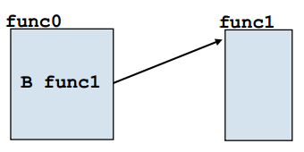
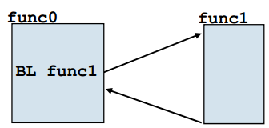
Instruction Set Architecture
Branch instructions
B – Branch
Absolute branch to a target address, relative to
Program Counter (PC)
+/- 256 bytes range, conditional execution supported
+/- 1MB range, no conditional execution supported
BL – Branch with Link
Branch to a subroutine – Link register is updated
+/- 16MB range, relative to Program Counter (PC)

Slide 28
Instruction Set Architecture
Data Processing Instructions:
Consist of :
Arithmetic: ADD ADC SUB SBC RSB RSC
Logical: AND ORR EOR BIC
Comparisons: CMP CMN TST TEQ
Data movement: MOV MVN
These instructions only work on registers, NOT memory.
Syntax:
<Operation>{<cond>}{S} Rd, Rn, Operand2
Comparisons set flags only - they do not specify Rd
Data movement does not specify Rn
Second operand is sent to the ALU via barrel shifter.

Slide 29
Instruction Set Architecture
Using Barrel Shifter:
Register, optionally with shift operation
Shift value can be either be:
5 bit unsigned integer
Specified in bottom byte of another register.
Used for multiplication by constant
Immediate value
8 bit number, with a range of 0-255.
Rotated right through even number of positions
Allows increased range of 32-bit constants to be loaded directly into registers
Operand 1
Operand 2
Barrel Shifter
ALU
Result

Slide 30
Instruction Set Architecture
Load and store instructions:
LDR STR Word
LDRB STRB Byte
LDRH STRH Halfword
LDRSB Signed byte load
LDRSH Signed halfword load
Memory system must support all access sizes
Syntax:
LDR{<cond>}{<size>} Rd, <address>
STR{<cond>}{<size>} Rd, <address>
e.g. LDREQB

Slide 31
Instruction Set Architecture
Status Register Access Instructions
MRS/MSR - Move data between a general purpose register and status register
MRS (Register ← Status Register)
MSR (Status Register ← Register)
Syntax:
LDR{<cond>}{<size>} Rd, <address>
STR{<cond>}{<size>} Rd, <address>

Slide 32
Table of contents
General Information about the Cortex-M
Introduction to the architecture
Programmer Model
Instruction Set
Summary
Notes:
Giới thiệu về các mục của buổi học:
Phần 1: Giới thiệu thông tin tổng quan về ARM Cortex, các dòng chip của ARM, sự khác nhau giữa các dòng.
Phần 2: Giới thiệu về kiến trúc tổng quan của ARM Cortex
Phần 3: Programmer Model
Phần 4: Kiến trúc tập lệnh sử dụng trong Arm cortex
Phần 5: Tổng kết

Slide 33
Summary
All the ARM Cortex M processors are 32-bit RISC (Reduced Instruction Set
Computing) processors. They have:
32-bit registers
32-bit internal data path
32-bit bus interface
The Cortex-M processors contain the core of the processor, NVIC, the SysTick timer, and optionally the floating point unit (for Cortex-M4).
All the ARM Cortex -M processors are based on Thumb technology, which allows a mixture of 16-bit and 32-bit instructions to be used within

Slide 34
Question & Answer
Thanks for your attention !

Slide 35
Copyright
This course including Lecture Presentations, Quiz, Mock Project, Syllabus, Assignments, Answers are copyright by FPT Software Corporation.
This course also uses some information from external sources and non-confidential training document from Freescale, those materials comply with the original source licenses.

